Slide 1
Robot Mapping
Short Introduction to Particle
Filters and Monte Carlo
Localization

Slide 2
Example

Slide 3
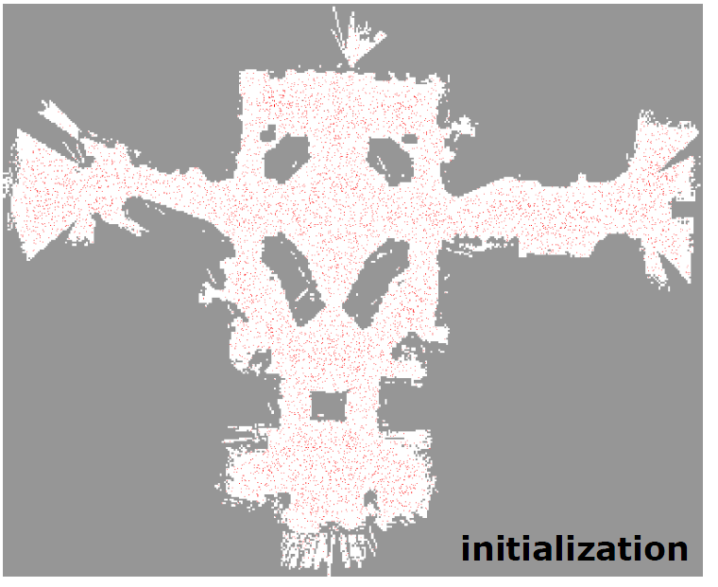

Slide 4
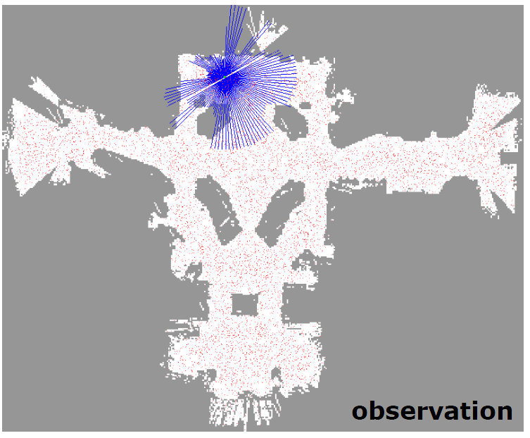

Slide 5


Slide 6
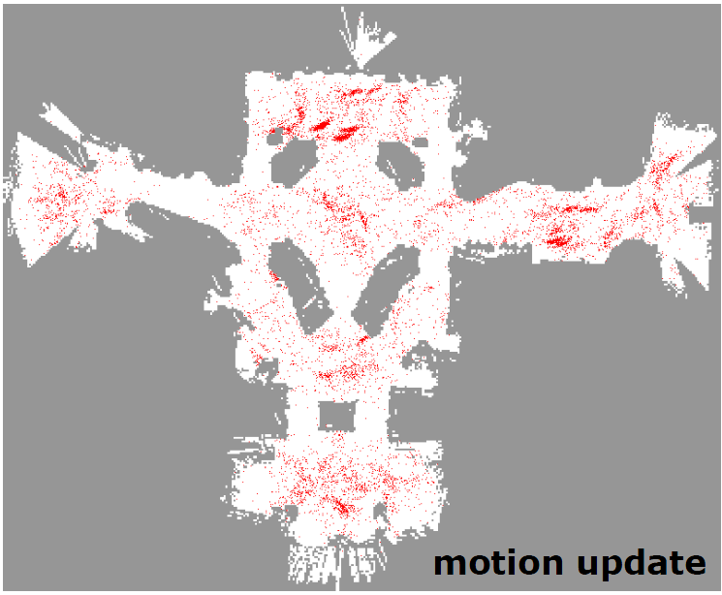

Slide 7
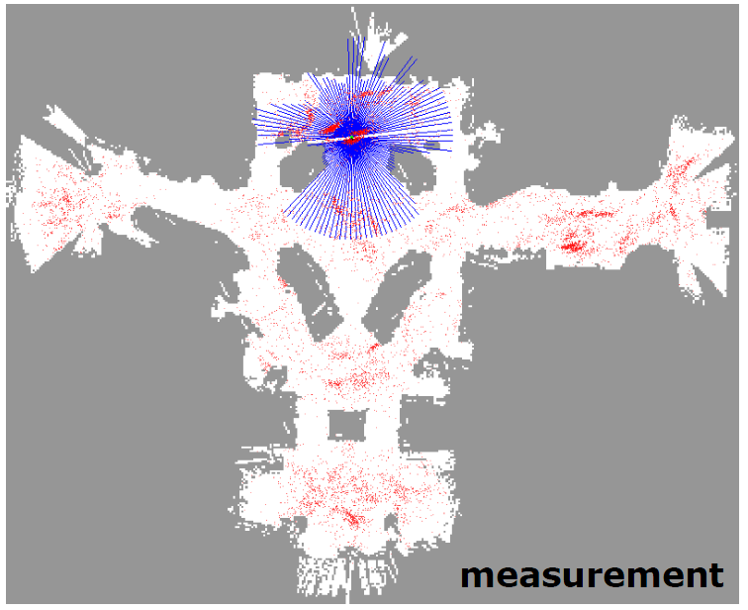

Slide 8
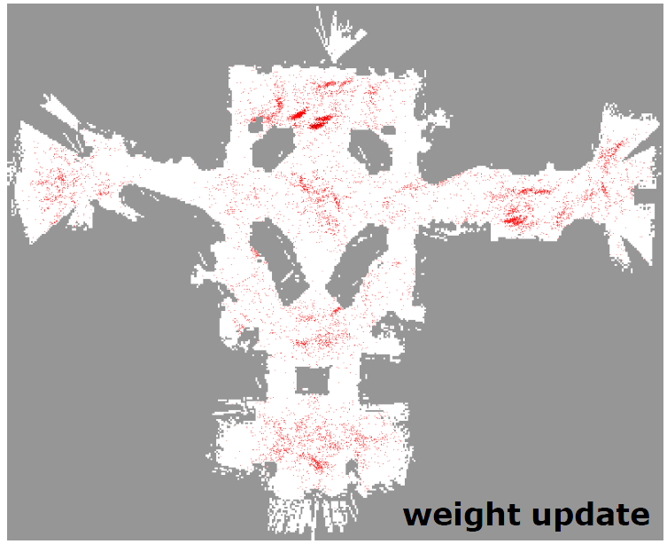

Slide 9
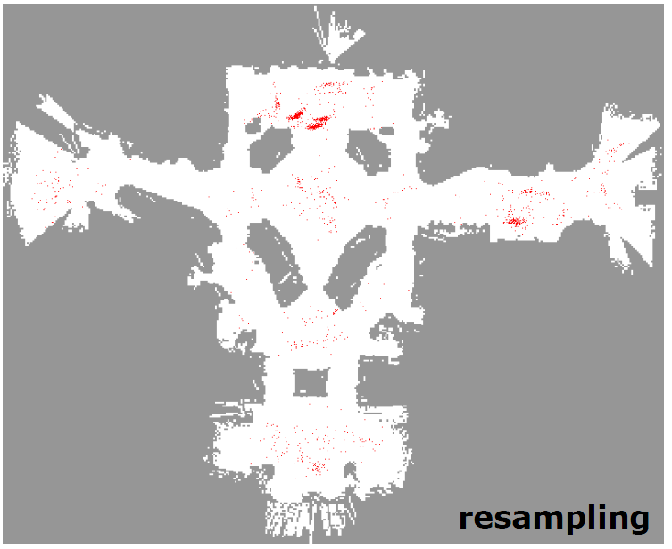

Slide 10
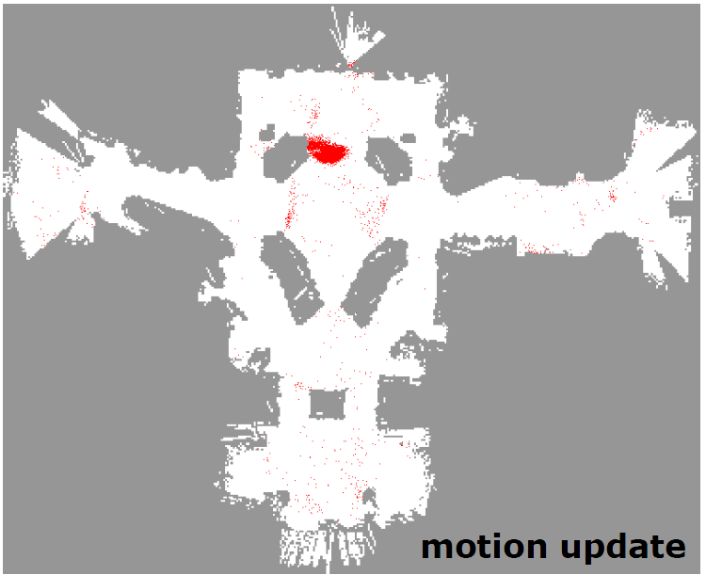

Slide 11
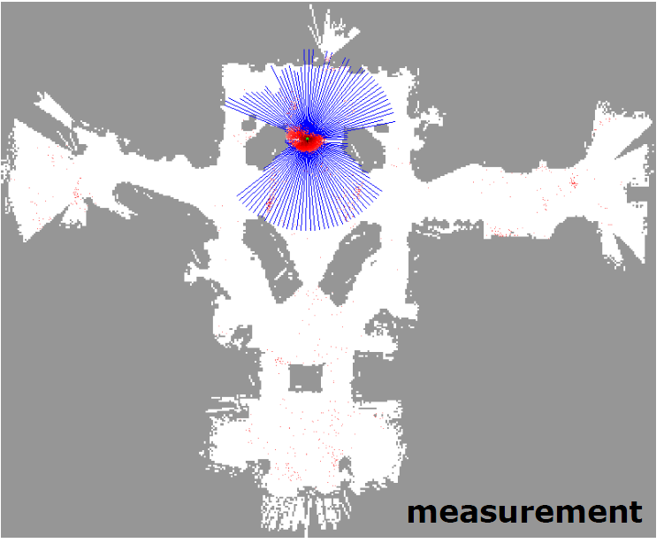

Slide 12


Slide 13


Slide 14


Slide 15
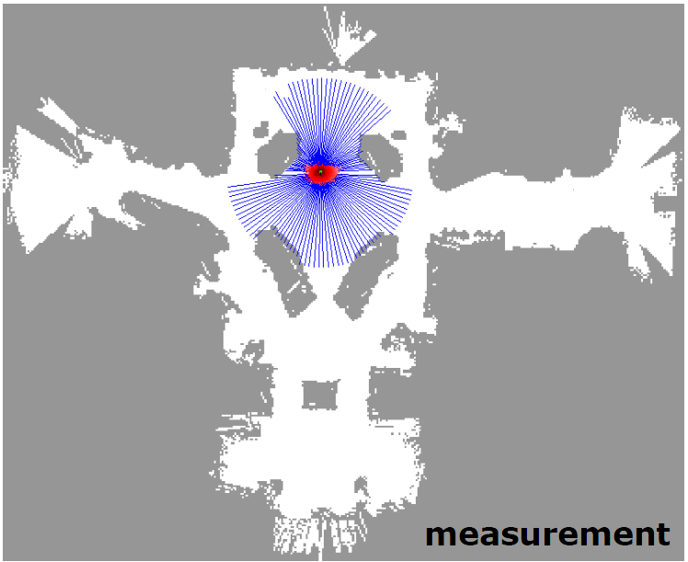

Slide 16


Slide 17


Slide 18


Slide 19
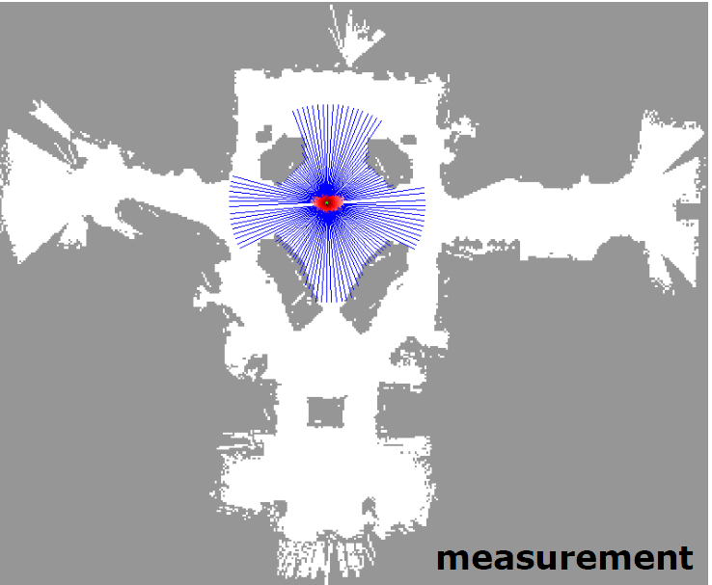

Slide 20
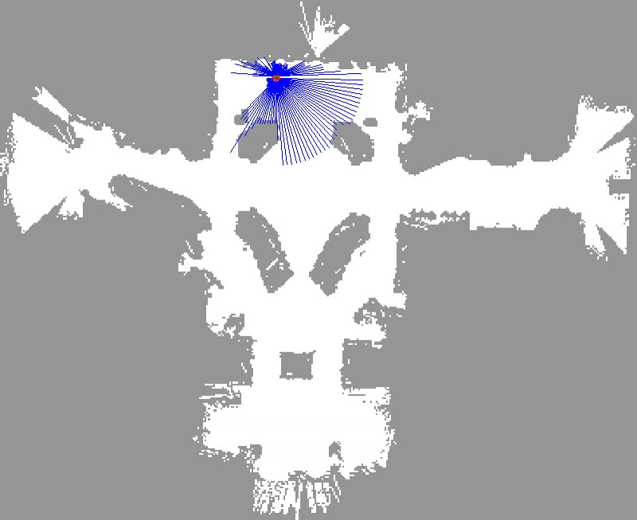

Slide 21
Another Example

Slide 22
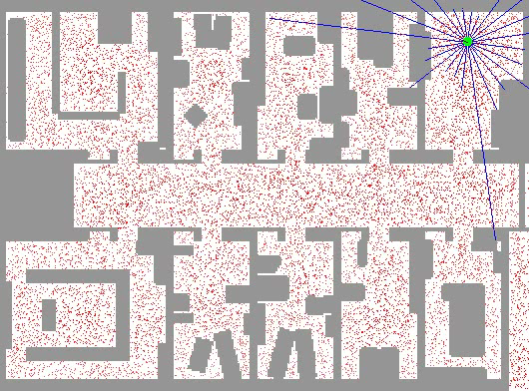
Sample-based Localization (sonar)

Slide 23
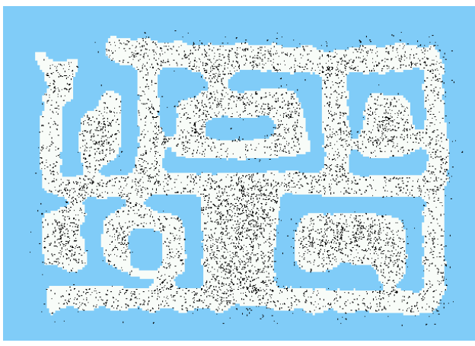
Initial Distribution

Slide 24
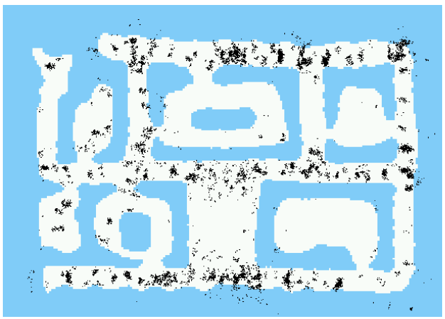
After Incorporating Ten Ultrasound Scans

Slide 25
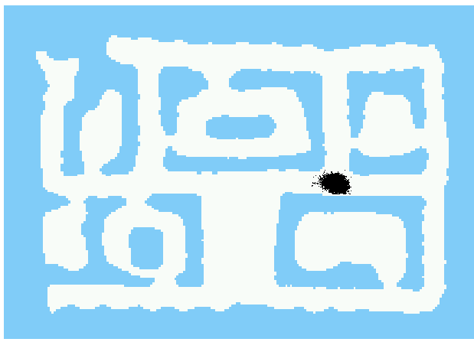
After Incorporating 65 Ultrasound Scans

Slide 26
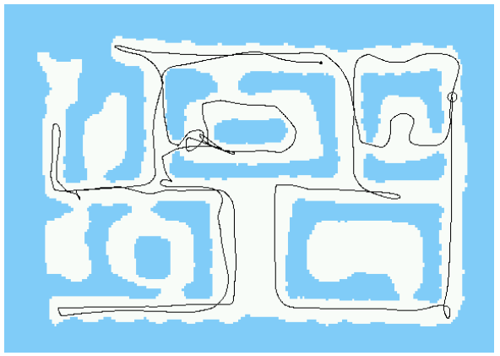
Estimated Path

Slide 27
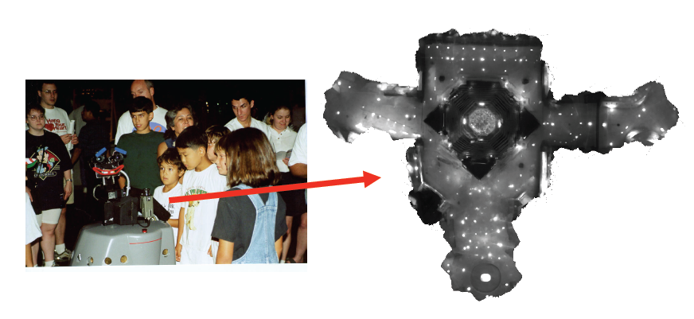
Using Ceiling Maps for Localization

Slide 28
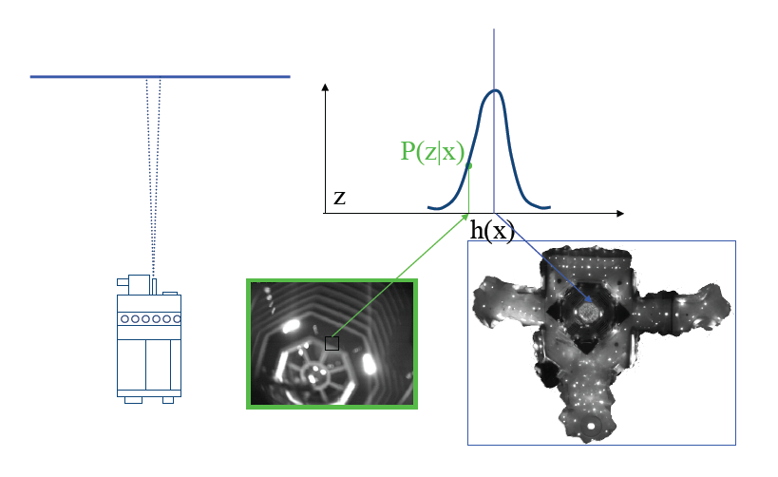
Vision-Based Localization

Slide 29
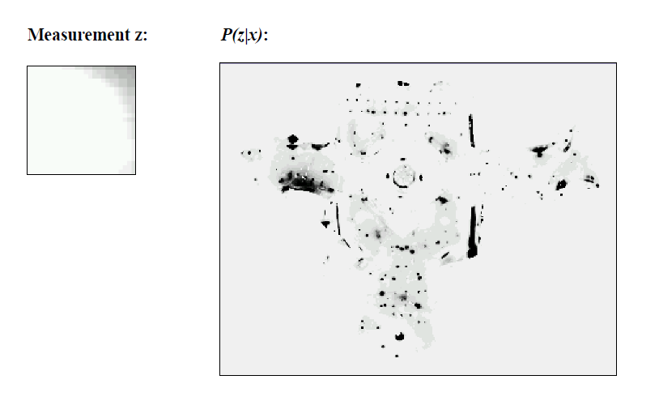
Under a Light

Slide 30
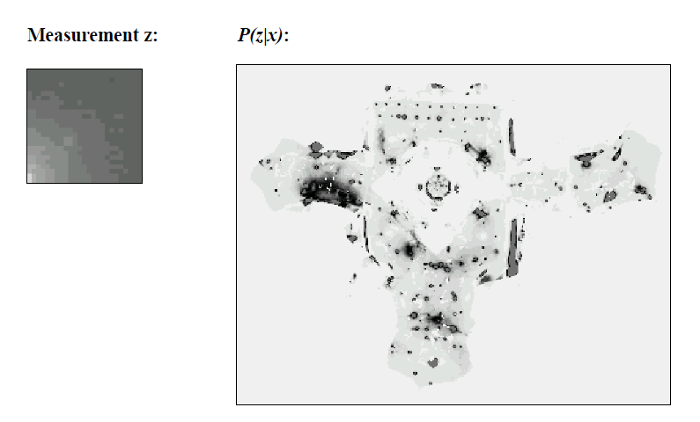
Next to a Light

Slide 31
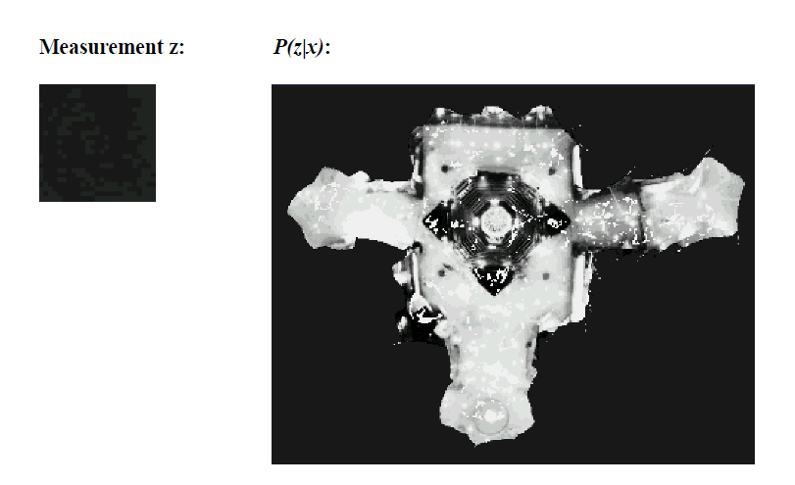
Elsewhere

Slide 32
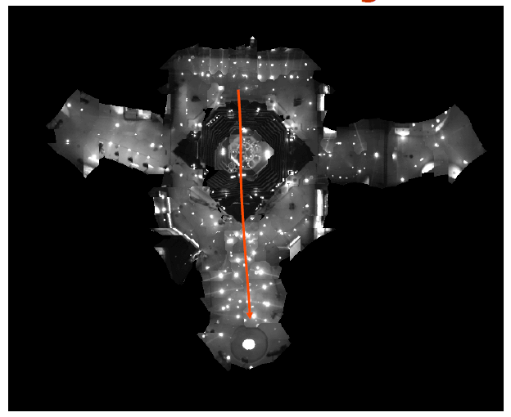
Global Localization Using Vision

Slide 33
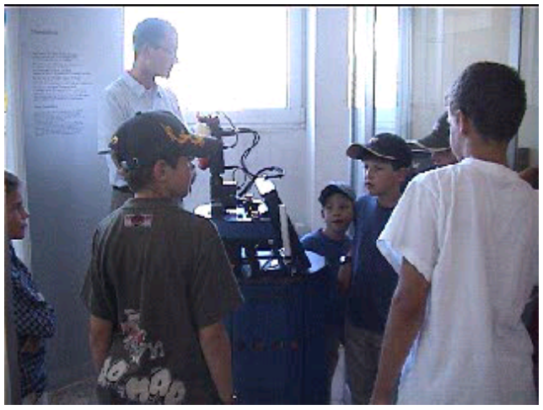
Robot in Action: Albert

Slide 34
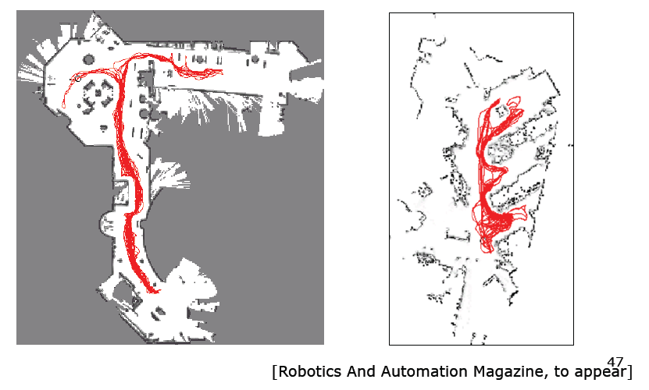
Application: Rhino and Albert Synchronized in Munich and Bonn

Slide 35
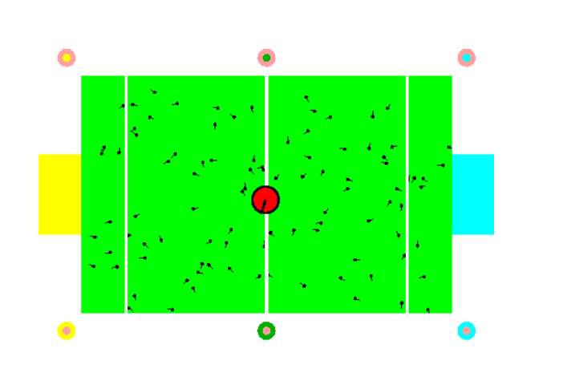
Localization for AIBO robots

Slide 36
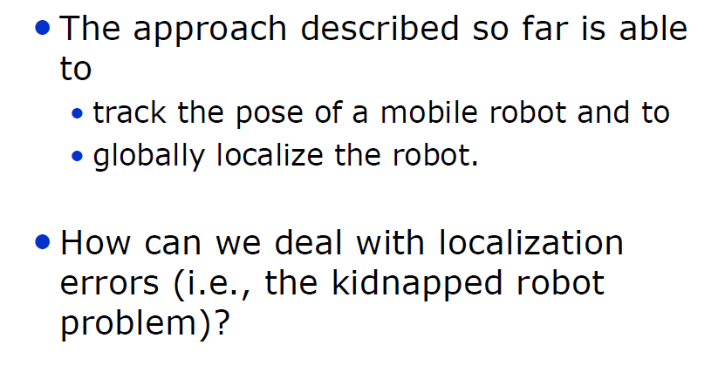
Limitations

Slide 37
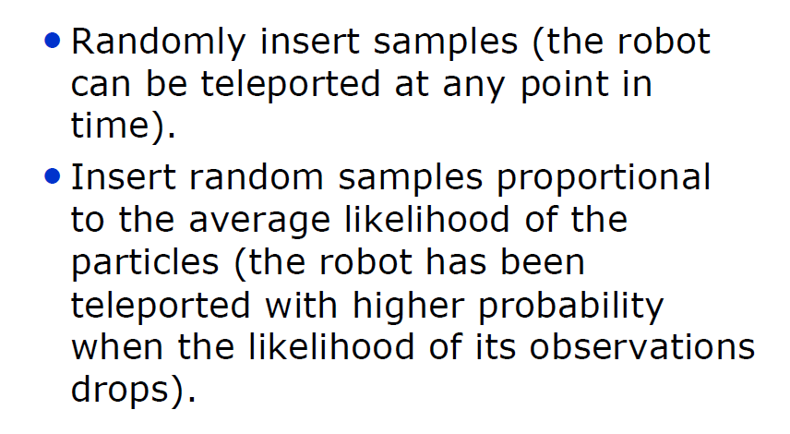
Approaches

Slide 38
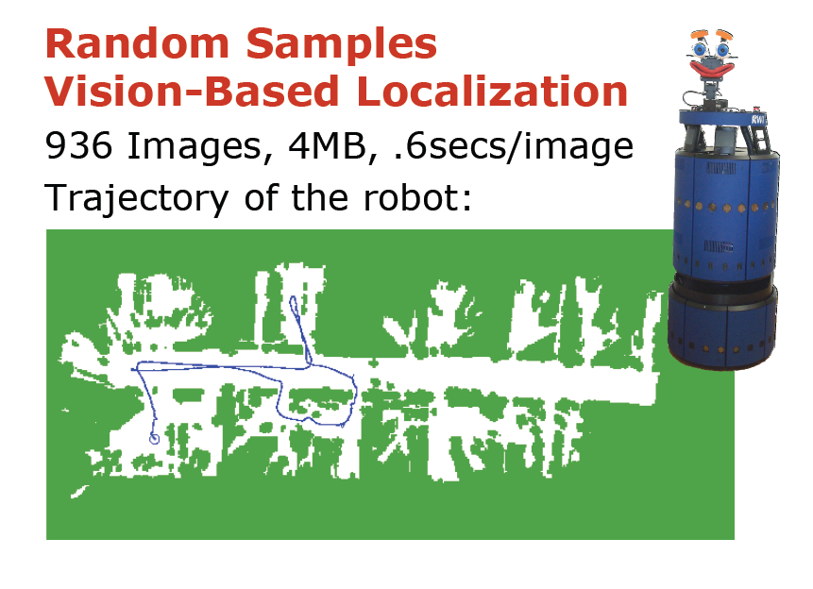

Slide 39
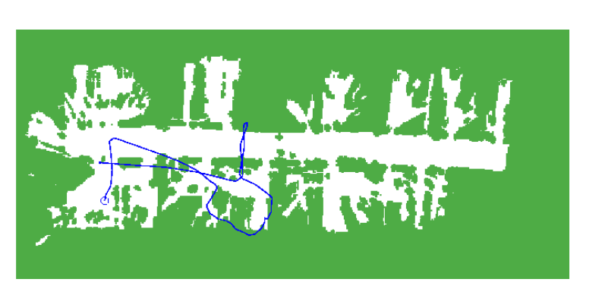
Odometry Information

Slide 40
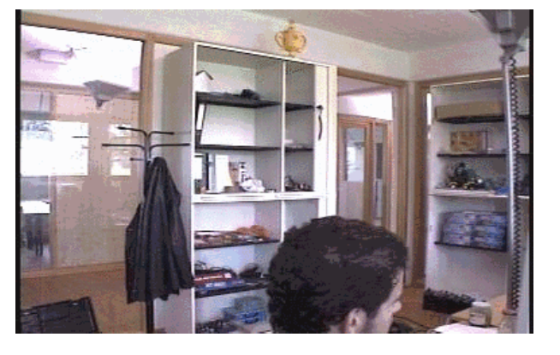
Image Sequence

Slide 41
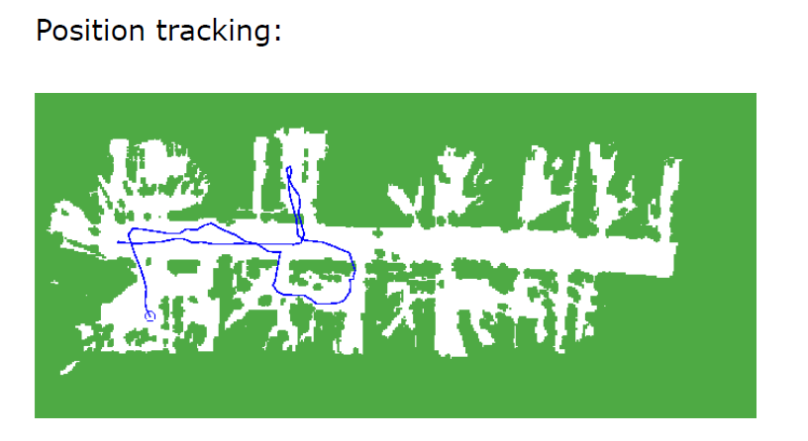
Resulting Trajectories

Slide 42
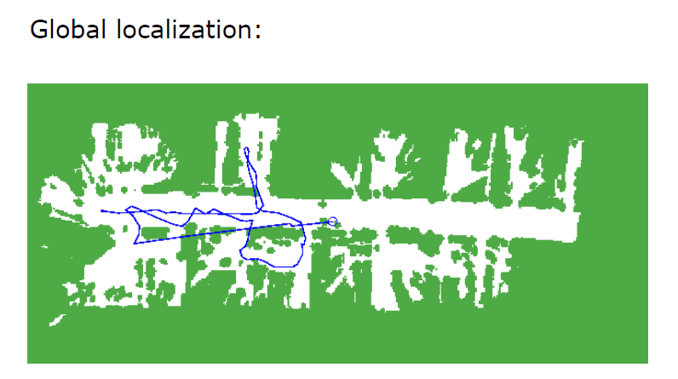
Resulting Trajectories: Global Localization

Slide 43
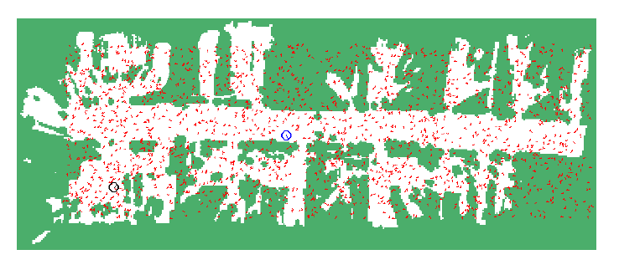
Global Localization

Slide 44
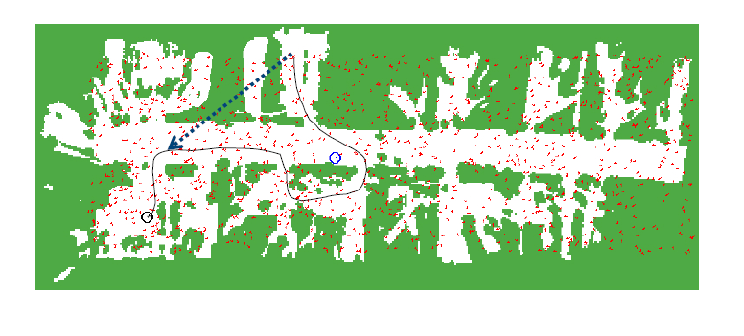
Kidnapping the Robot

Slide 45
Kidnapping: Approaches
Randomly insert samples (the robot can be teleported at any point in time).
Insert random samples proportional to the average likelihood of the particles (the robot has been teleported with higher probability when the likelihood of its observations drops).

Slide 46
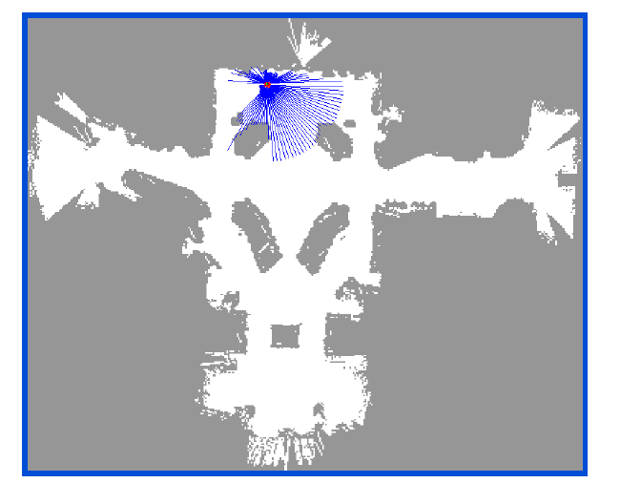
Recovery from Failure

Slide 47
Summary
• Particle filters are an implementation of recursive Bayesian filtering
• They represent the posterior by a set of weighted samples.
• In the context of localization, the particles are propagated according to the motion model.
• They are then weighted according to the likelihood of the observations.
• In a re-sampling step, new particles are drawn with a probability proportional to the likelihood of the observation

Slide 48
Limitations
The approach described so far is able to
  track the pose of a mobile robot and to
  globally localize the robot.
How can we deal with localization errors (i.e., the kidnapped robot problem)?

Slide 49
Summary – Particle Filters
Particle filters are an implementation of recursive Bayesian filtering
They represent the posterior by a set of weighted samples
They can model non-Gaussian distributions
Proposal to draw new samples
Weight to account for the differences between the proposal and the target
Monte Carlo filter, Survival of the fittest, Condensation, Bootstrap filter

Slide 50
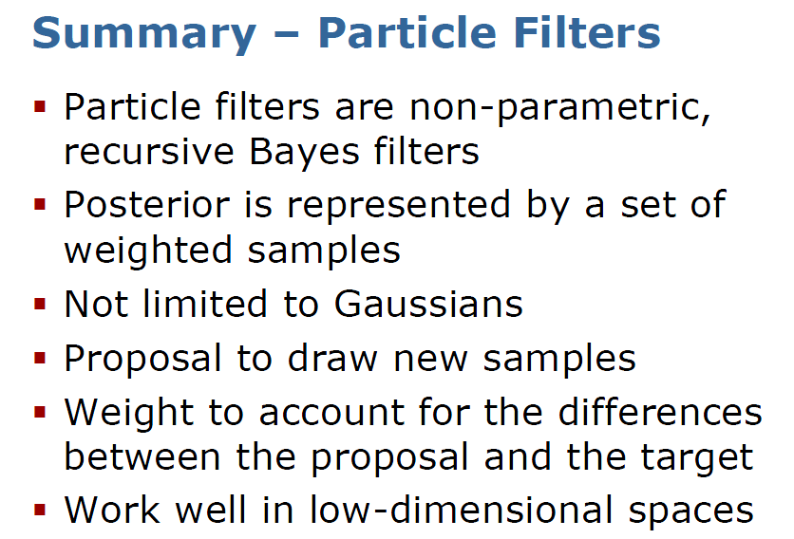

Slide 51
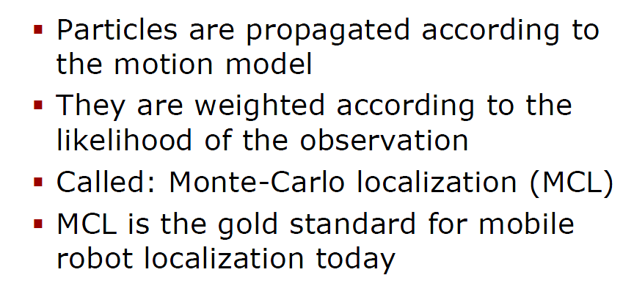
Summary – PF Localization

Slide 52
Summary – Monte Carlo Localization
In the context of localization, the particles are propagated according to the motion model.
They are then weighted according to the likelihood of the observations.
In a re-sampling step, new particles are drawn with a probability proportional to the likelihood of the observation.

Slide 54
Robot Mapping
Short Introduction to Particle
Filters and Monte Carlo
Localization
Cyrill Stachniss

Slide 55
Probabilistic Robotics:
Monte Carlo Localization
Sebastian Thrun & Alex Teichman
Slide credits: Wolfram Burgard, Dieter Fox, Cyrill Stachniss, Giorgio Grisetti, Maren Bennewitz, Christian Plagemann, Dirk Haehnel, Mike Montemerlo, Nick Roy, Kai Arras, Patrick Pfaff and others

